Slide 1
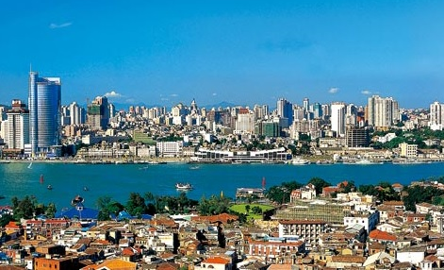
Website Design for tourist attraction
Website Design of John-Abbott College

Slide 2
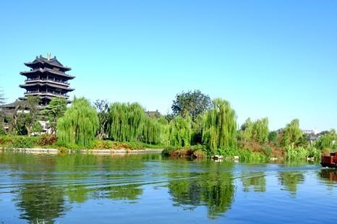
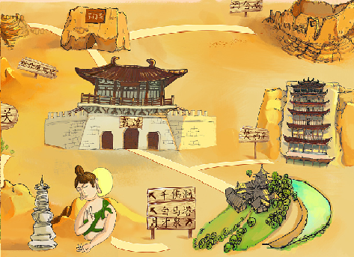


Contents
Team member
Purpose
Planning
Implementation
Project Management

Slide 3




Summary·
Summary

Slide 4


Team Members
Guo
Lin
Shen
Su
Zhao

Slide 5
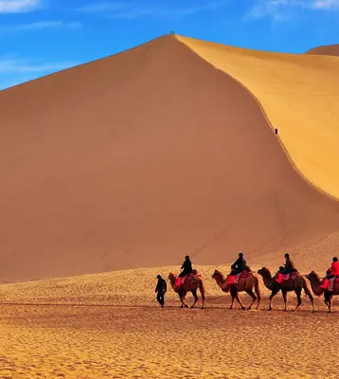
Purpose
Introduction

Slide 6
Purpose
Our project is to design, develop, publish, and maintain a web site of introduction of China tourist attractions by using learned design practices.
we worked in team from beginning to the end for preparing final project. We use all related techniques covered in this course such as HTML and CSS languages.
We use the IDE MS visual studio.
Our team have a total planning for the new Web site involves understanding in two key areas: knowledge of the web required logical side, and knowledge of the creative side.
Begin with a plan, create a visual mind map, create sample page sketches and wireframes (mockups), generate a timeline, assemble the site, create a marketing plan, and create a storyboard.

Slide 7
Planning
Aug.27 ~ Aug.28

Slide 8
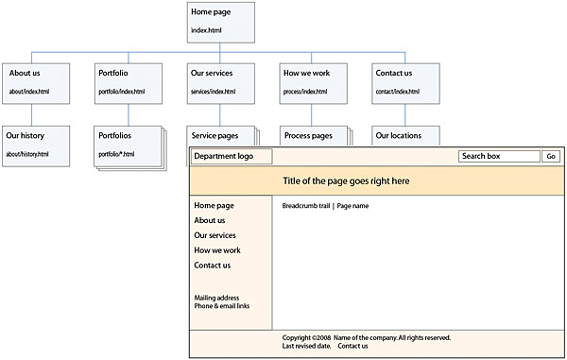
Planning
1. Define the purpose and target audience.
To introduce some famous viewpoints of China.
Some people want to travel to China are audience.
2. Determine the web pages that be on the website by sketching the navigation structure. Review and revise the sketches as needed.

Slide 9
Planning

Slide 10
Implementation
Aug.29 ~ Aug.31

Slide 11
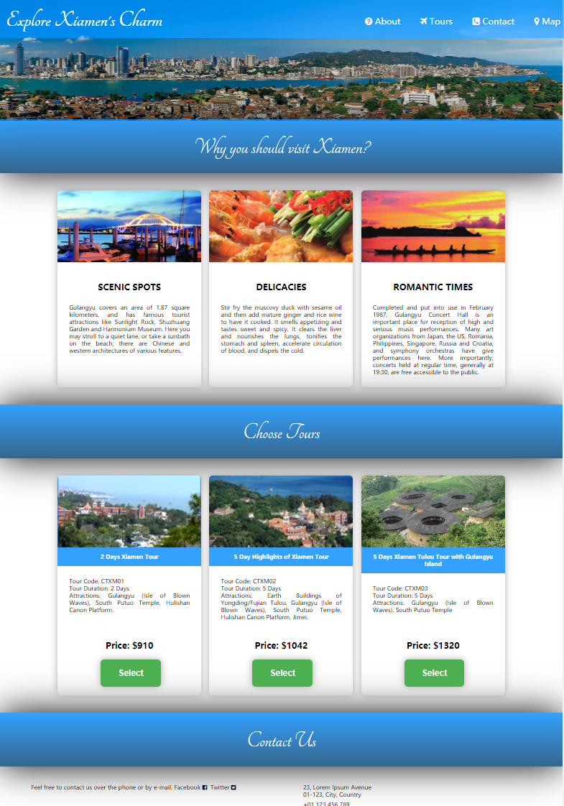
Implementation
. Create the web pages using an IDE.
MS Visual Studio
. Review the website in a browser and review a printed copy of each web page.
Team reviews every web page and check if they are running well.
. Make changes or corrections.
Do final change and adjustment.

Slide 12
Implementation
Aug.29 ~ Aug.31

Slide 13
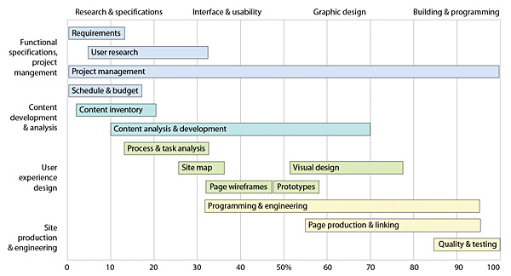
Project management

Slide 14
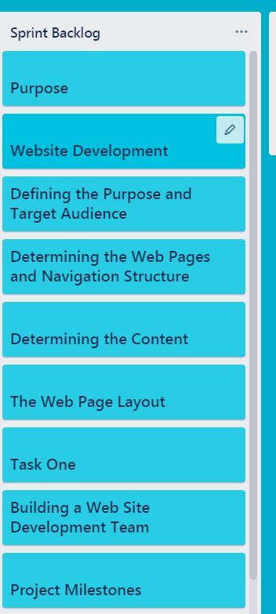
Spring Method

Slide 15
Schedule
1
launch
2
Planing
3
4
create
Final
5
Adjustment

Slide 16


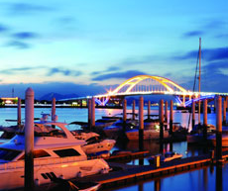
Team
Team member (5):
Guo Shengguang,
Lin Hong,
Shen Fan,
Su Xiaoming,
Zhao Guixia

Slide 17

Thank you Merci 谢谢

